Slide 1

The MP3 Smart Shuffler
William Frost, Mariah Moore, Letitia Pinter, Eric Van Wig

Slide 2
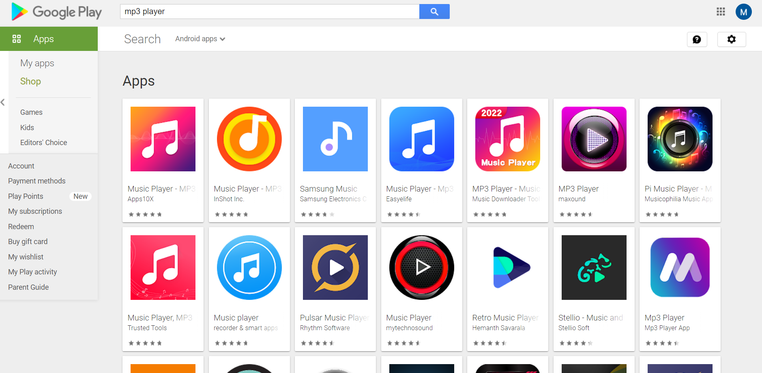
Why
Looked at many different MP3 player apps
Wanted to improve on the overlooked MP3 user community
Wanted the inclusion of a smart shuffle and exclusion list

Slide 3
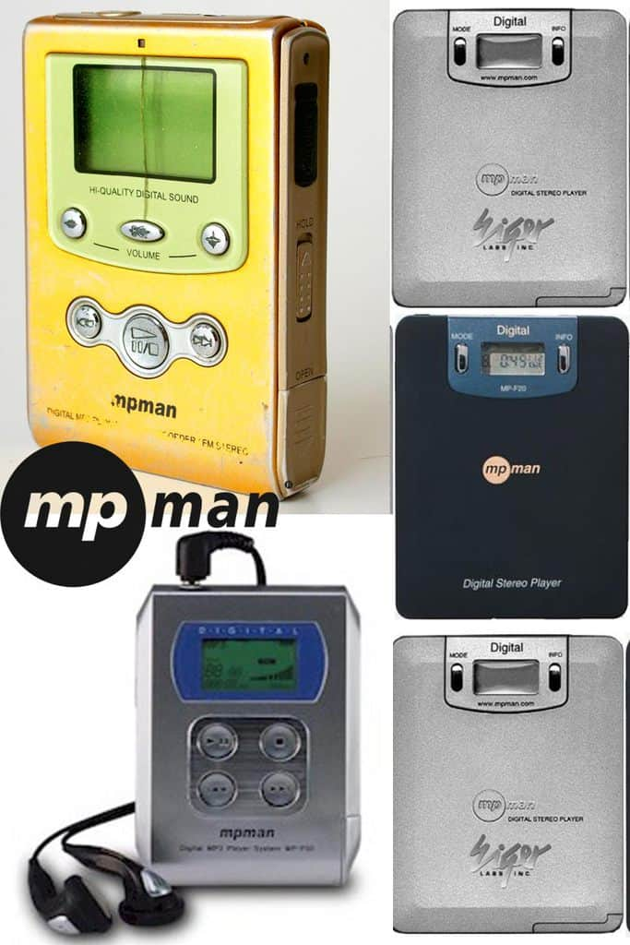
MP3 Use Cases of the Past
First portable MP3 player was MPManF10
Most Popular:
Winamp
Sonique
iTunes
MusicMatch
Became popular due to portability and capacity

Slide 4
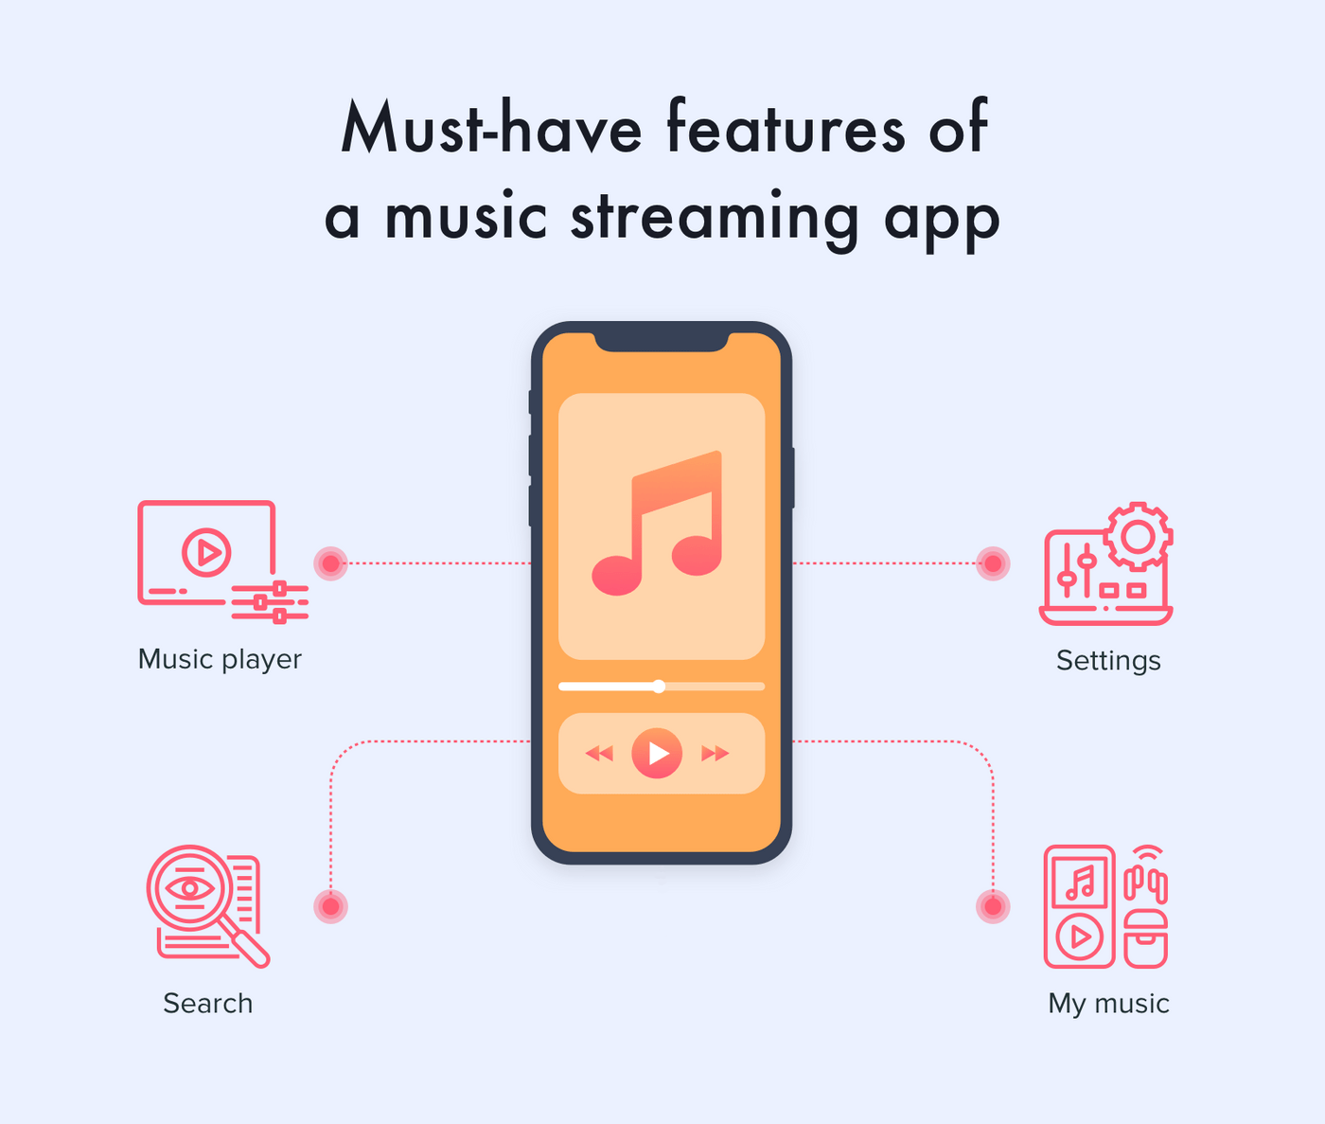
What is needed out of a music application?
Ease of use for users
Normal functionality
Control over user’s music library
Settings
Search

Slide 5
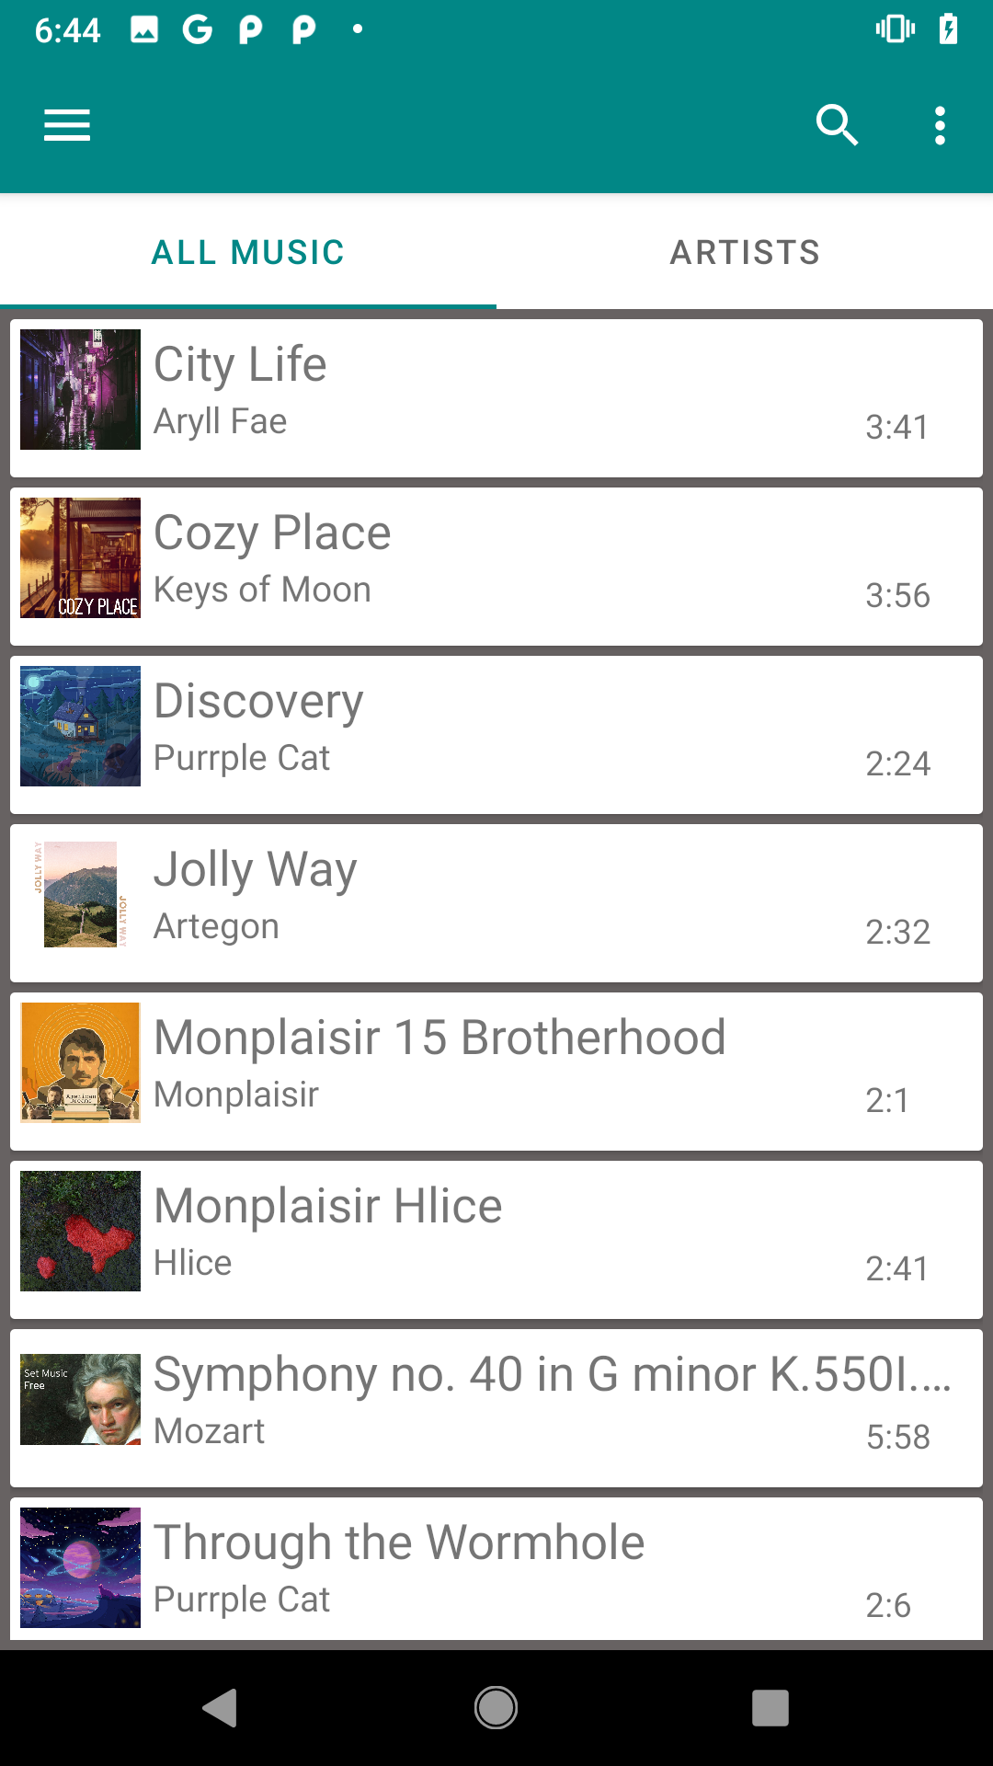
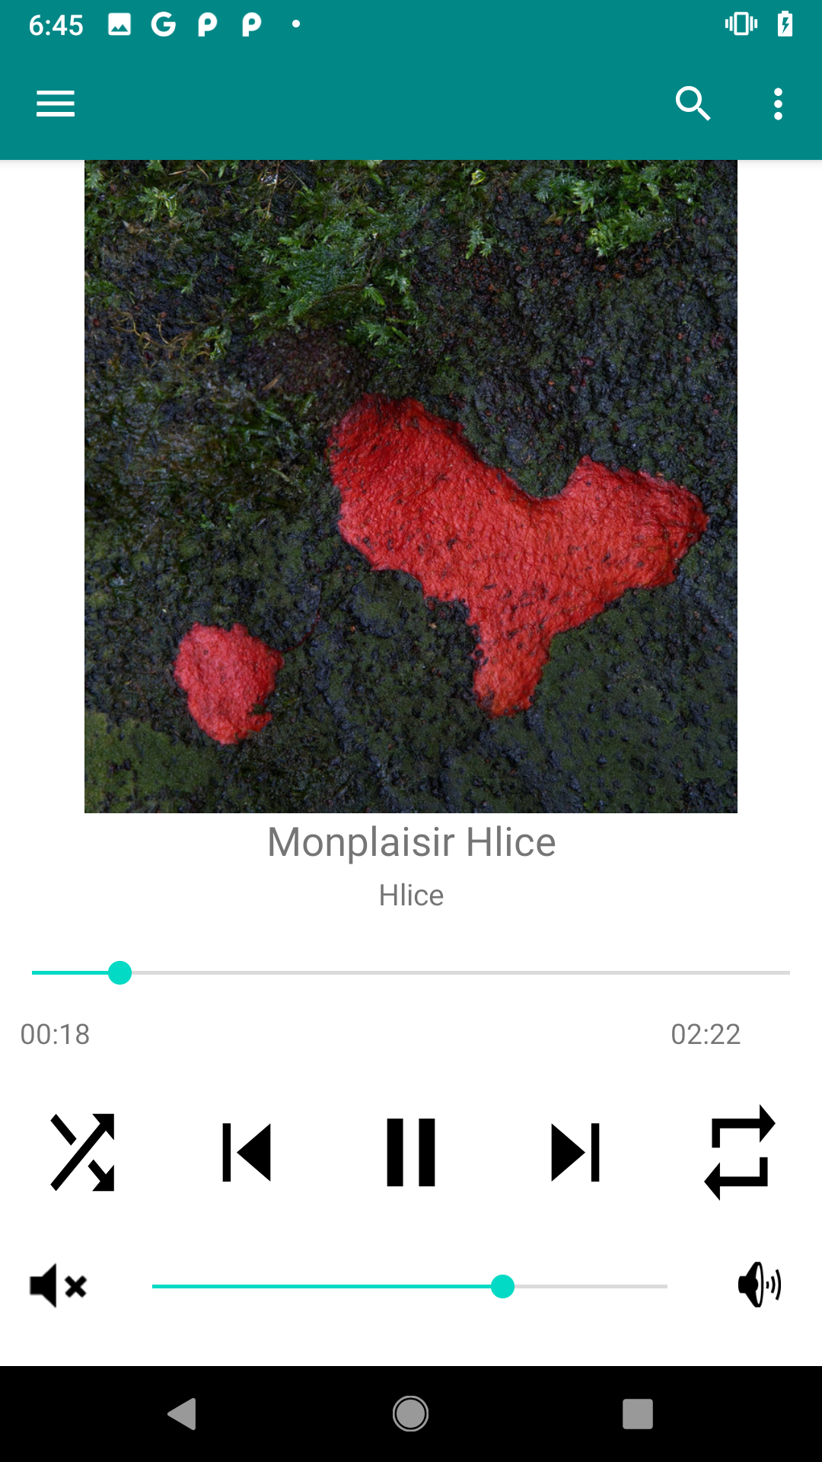

UI and Display
Opens to the library of all music on your device
Pressing on a song card takes you to the playback display screen

Slide 6
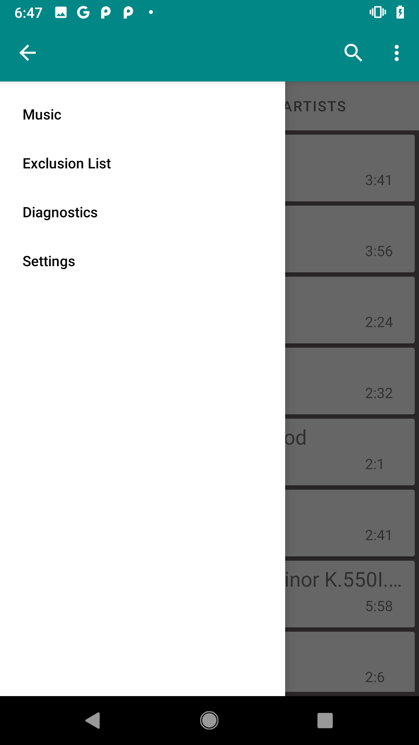
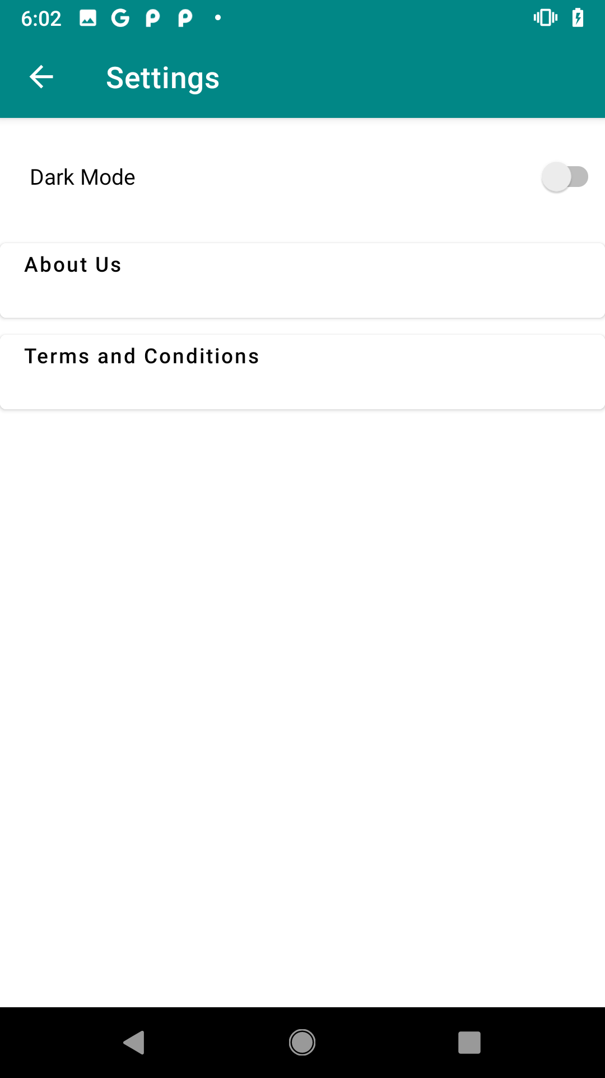
UI and Display Cont.

Slide 7
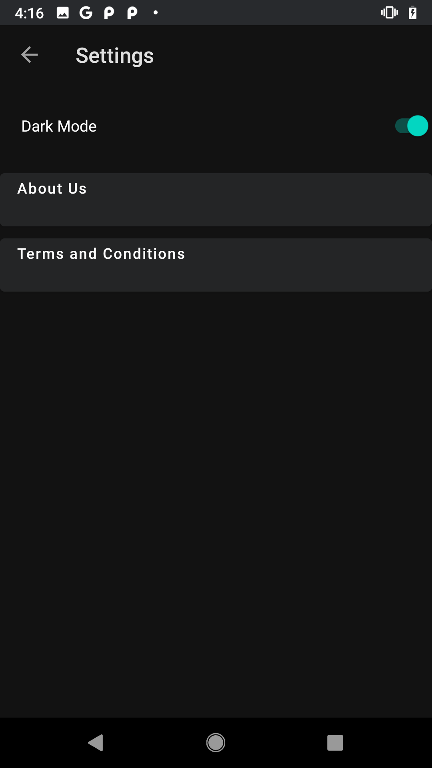
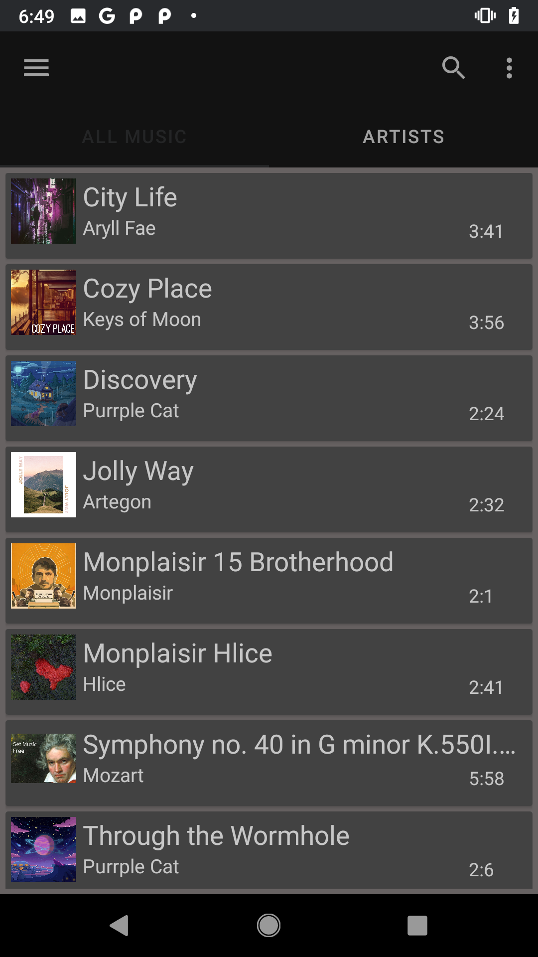
Dark Mode

Slide 8
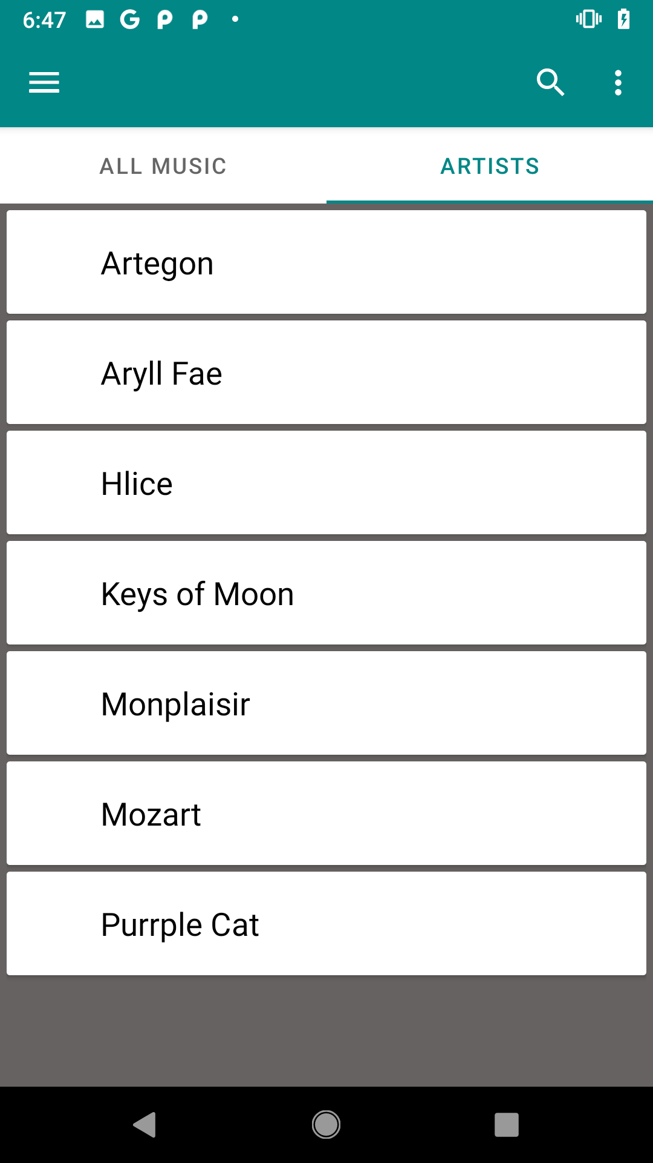
Sub-Menus
All Music and Artists
Can add other metadata
Genre
Album
Year

Slide 9
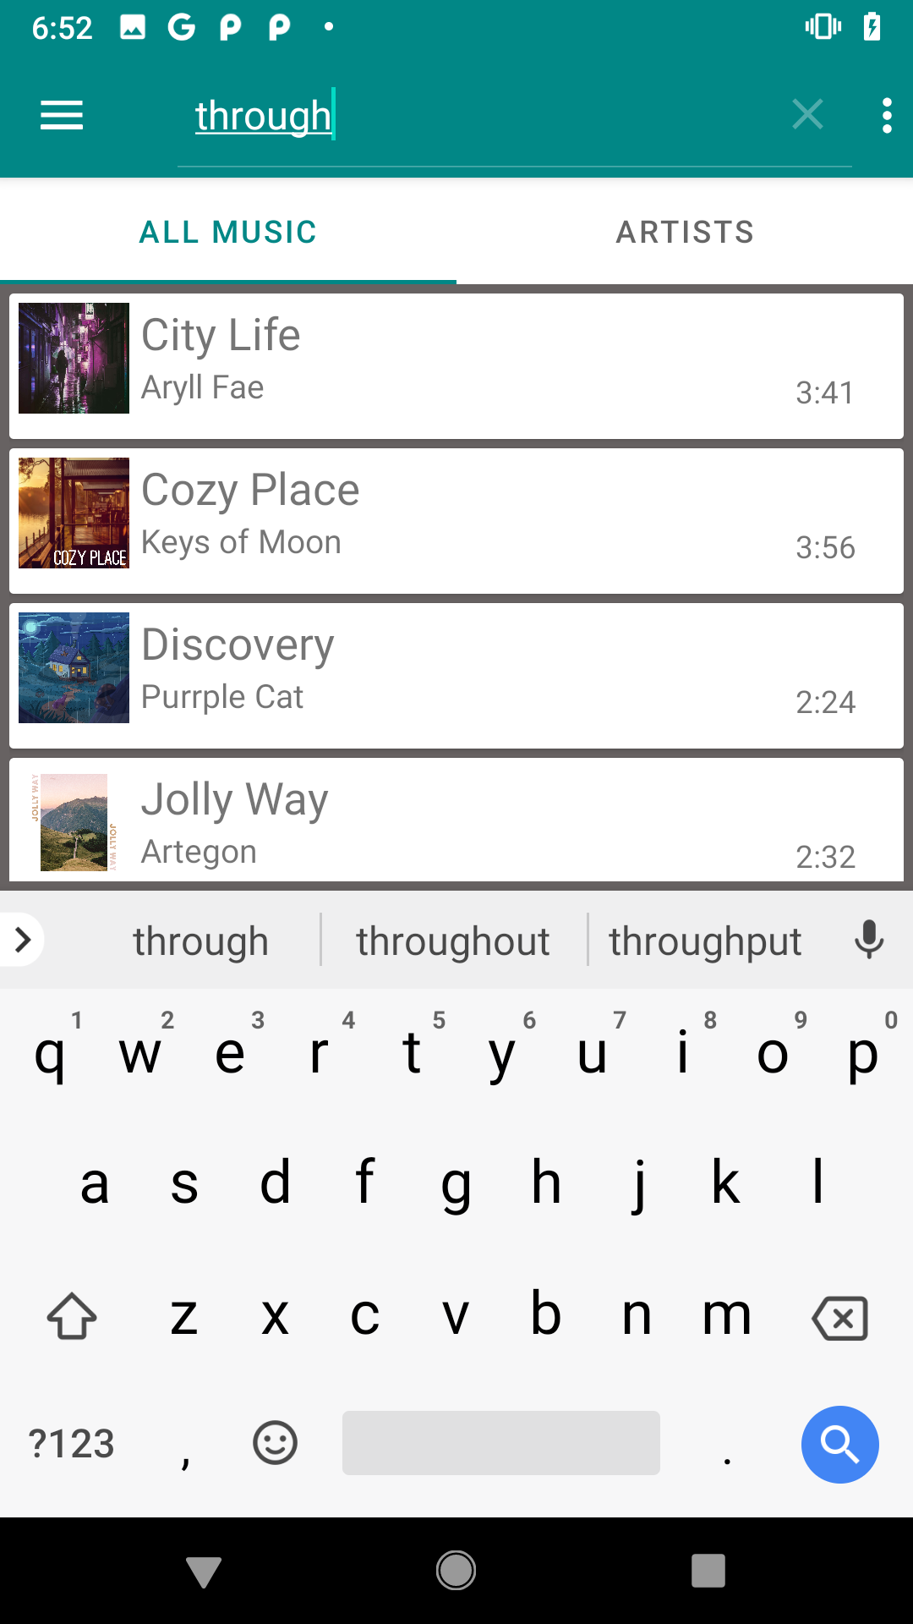
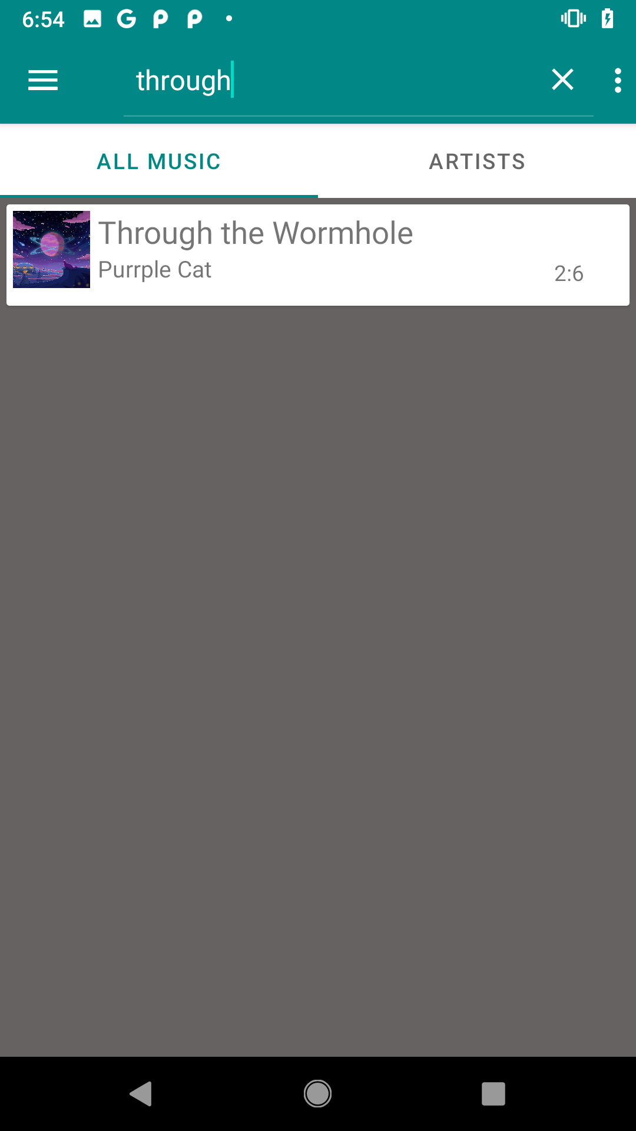
Search
1
Tap magnifying glass button
Type search query and press keyboard return
Search indexes over title and artist
Returns songs that contain all of the words in search query
2

Slide 10
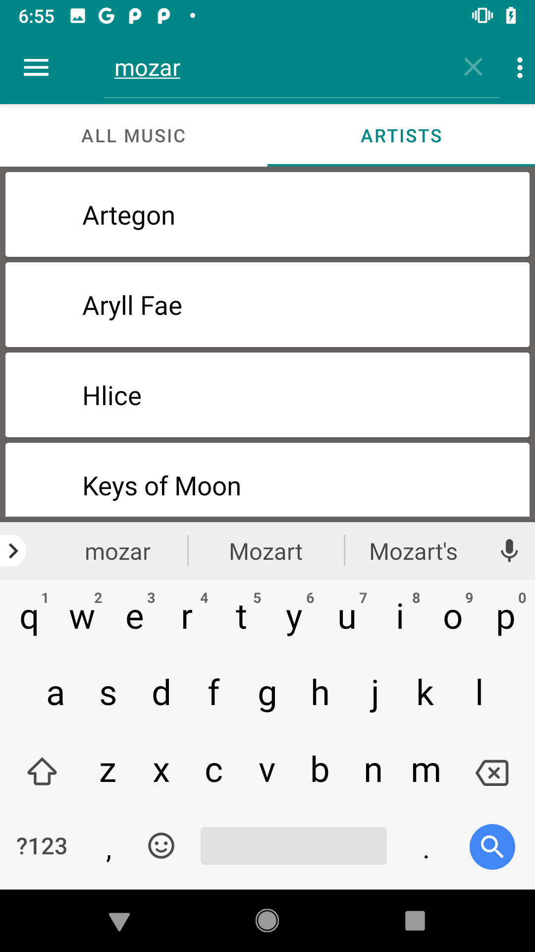
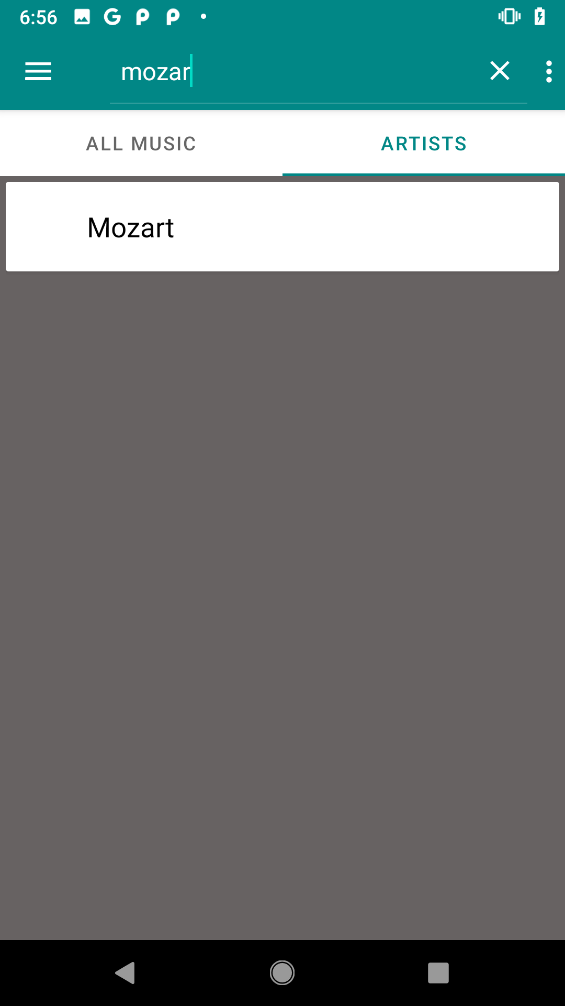
1
2

Slide 11

Search Specifics
Query separated into words at “ ” (space)
Search is not case sensitive
Searches artist name and song title if track has metadata
Searches file name if track does not have metadata
Tracks that contain all words of search query are added to search results

Slide 12
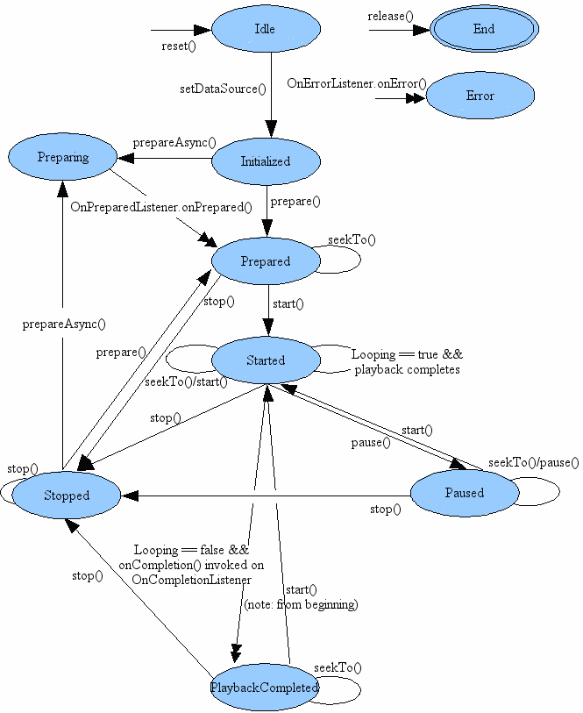
Audio Cycles
The Audio Cycle refers to the pathology of playback
Starts from Idle, moves to End (or Error)
Part of the MediaPlayer service
Can be moved through states by the program or the device

Slide 13
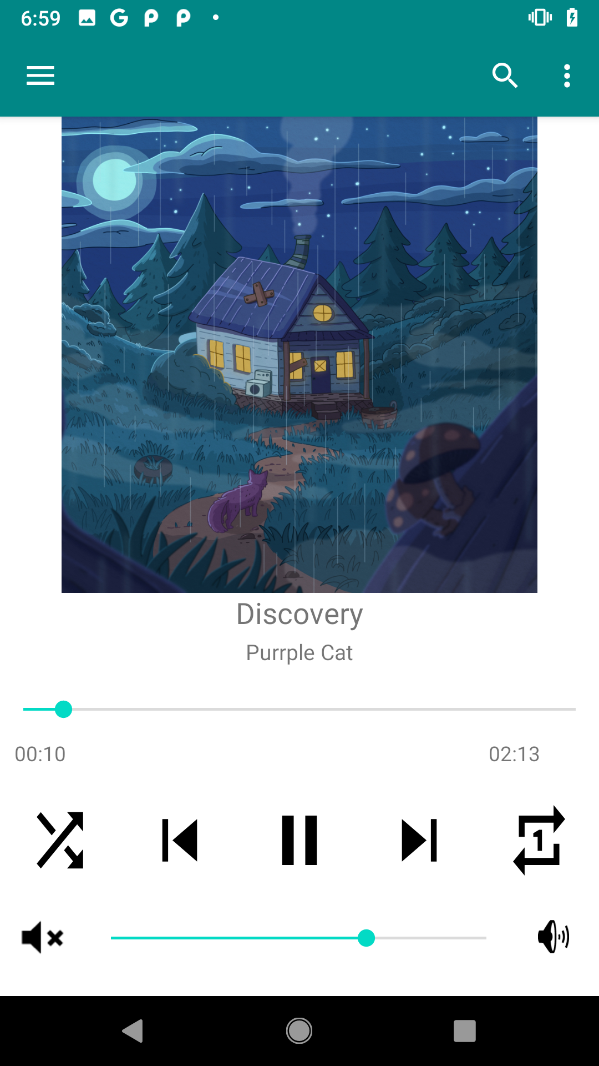
Media Playing Amenities
Shuffle
Repeat track
Repeat queue
Volume
SeekTo Slider

Slide 14

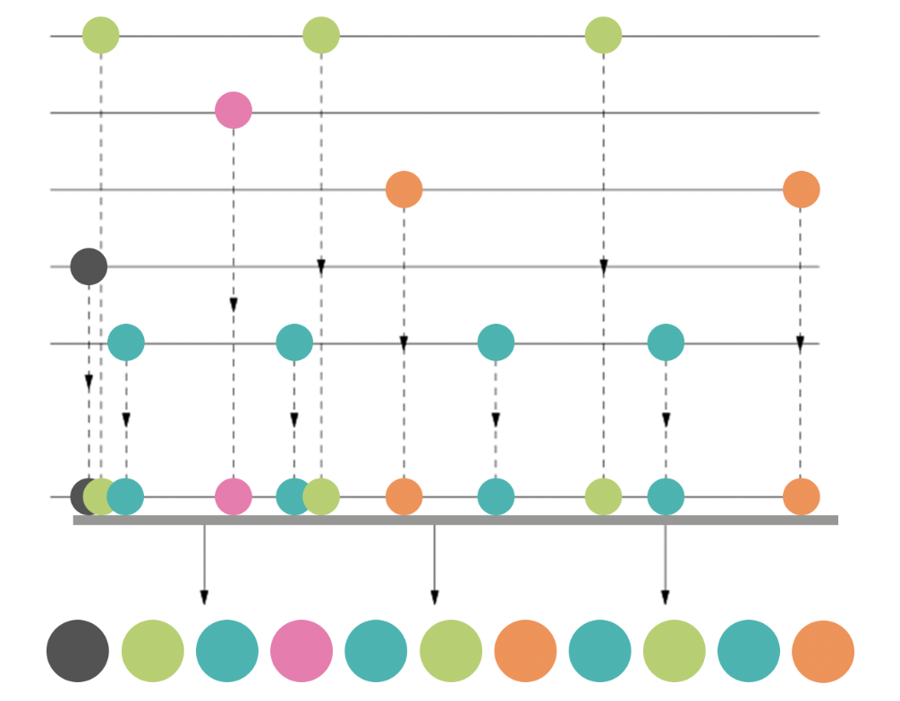

What do other shufflers do?
Spotify = Used to be fully random, now algorithm
iTunes = More mysterious and stored playlists
How Spotify’s Shuffle Algorithm Works, IMMENSITY Laforet, Hermes, 2020

Slide 15
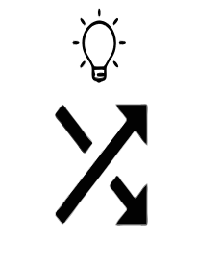
Smart Shuffler Overview
Smart Shuffle Mode
Curates the randomized playback based on user interaction
Smart Shuffle Value
Represents the likelihood of the song getting skipped
Data points
If/When the user skips
Repeated Actions

Slide 16

Smart Shuffler Specifics
Scaled Movement (Base, Minimum, Maximum)
Base of 8
Modified by the iterator value which tracks repeated actions
Occurs on Song Skip or Completed Playback
Becomes less likely to appear on early skip
Becomes (less) less likely on late skip or completion

Slide 17
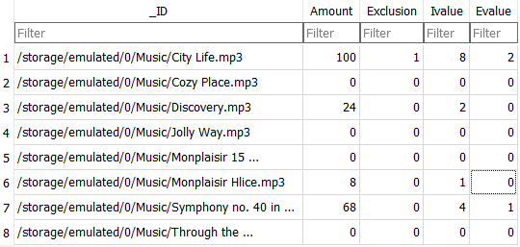
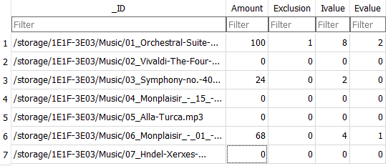
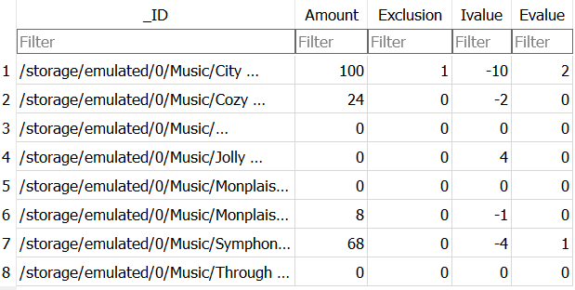
Database

Slide 18

Database Values
_ID = file path for the song
Amount = Amount a song has been skipped value
Exclusion = Boolean for whether the song is in the exclusion list or not
Ivalue = Incrementer value
Evalue = Exclusion message value

Slide 19

Smart Shuffler User Interaction
User clicks on shuffle until smart shuffle icon appears
5 repeated skips will result in the first exclusion list dialog
7 repeated skips displays the second dialog box
10 repeated skips will automatically exclude

Slide 20
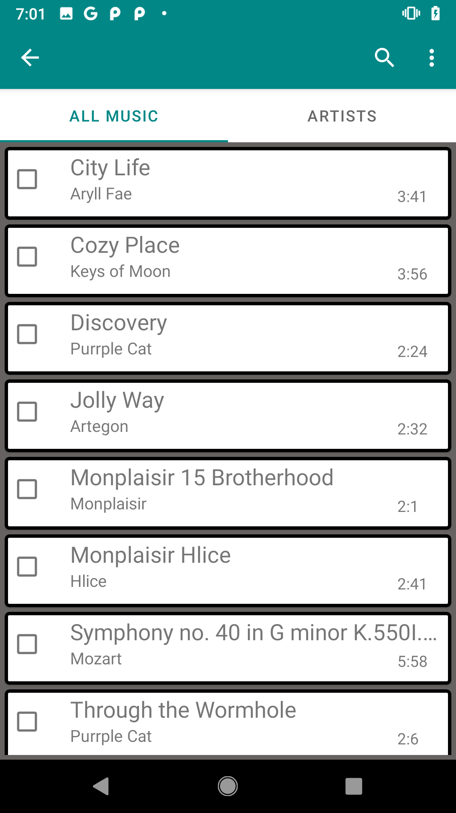
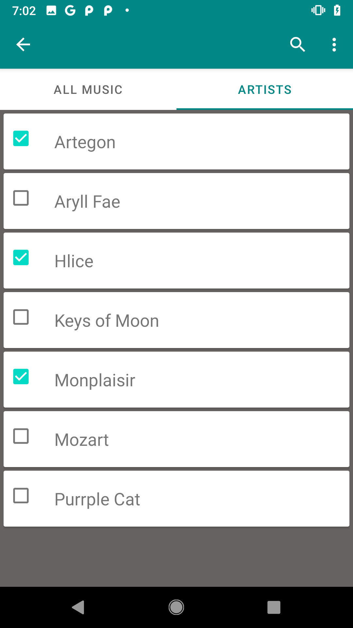
Exclusion List Overview
Checkbox for whether the song is excluded or not
To exclude, tap the unticked box
To remove from exclusion, tap the ticked box
Can exclude by song or exclude by artist

Slide 21

Exclusion List Implementation
Songs are added to exclusion list from a pop up
User will click yes or no to add to exclusion list
This message will be provided a maximum of 2 times before a reset
The exclusion list can be accessed as a separate menu

Slide 22
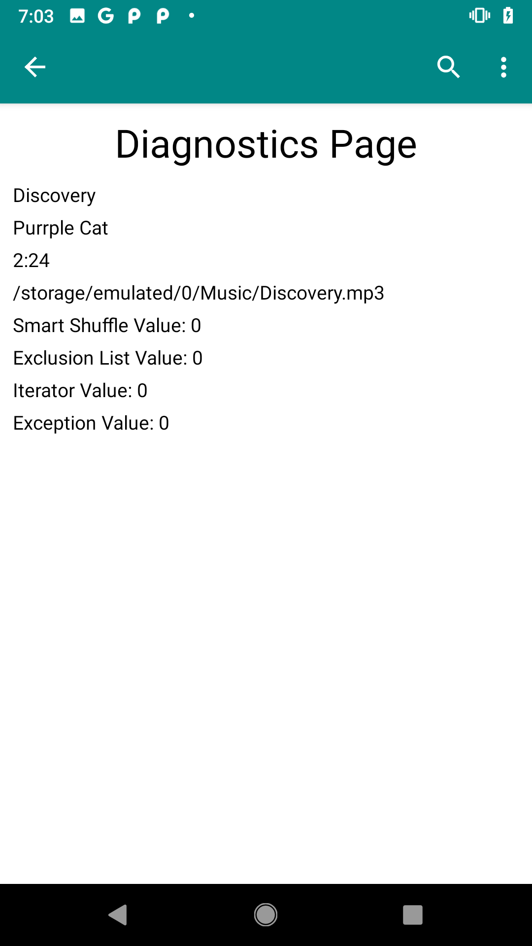
Diagnostics
Title
Artist
Duration
Database values
Dialog pop-up planned
User will be able to access this page

Slide 23

Future Stuff
Saving databases between devices
More subcategories
Enhanced smart shuffle
Category Preference Prediction
Notification bar and Notifications

Slide 24
Q&A

